Slide 1
Quantitative Research Methods
Matthew Ivory
matthew.ivory@lancaster.ac.uk

Slide 2
1. Introduction to the course
Session 1: Introduction to quantitative research methods using R
Session 2: Data management and data wrangling
Session 3: Exploratory data analysis
Session 4: Data visualization
Session 5: Mid-term Assignment
Session 6: Probability and distributions
Session 7: Tests for discrete variables: Analysing contingency tables
Session 8: Correlations and t-tests.
Session 9: ANOVA and linear regression
Session 10: Multiple regression, introduction to generalised linear regression

Slide 3
Our plan for today
1. Important concepts
Populations vs samples
Descriptive vs inferential statistics
Random samples and sample bias
Why is random sampling so important?
2. Distributions
Uniform
Exponential
Bimodal
Normal
Sampling distributions
3. Probability theory
Law of Large Numbers
Central Limit Theorem

Slide 4
Important concepts
Populations and samples
Descriptive statistics vs inferential statistics
Random samples and sample bias
Why is random sampling so important?

Slide 5
Populations
A defined set of individuals, events, objects that we want to know something about.
The population includes all members of a defined group.

Slide 6
Populations do not need to be large…
The distinguishing characteristic is not size!
It is that all those who meet the definition for membership are included.
Example: The population of the UK, students at Lancaster University, postgraduates at FASS, enrolled students in FASS512…

Slide 7
Samples
A subset of the population that we are interested in.
To determine characteristics of the population, we take random samples of the population.

Slide 8
Populations and samples
Usually, we cannot count and observe everything because it would be too time-consuming or expensive.
Instead, we often rely on examining parts of a population (samples) to learn something about the population.

Slide 9
Conventions
When referring to populations:
Descriptive measures of a population are called parameters.
When referring to population parameters, we use Greek letters (or uppercase letters).
Example Greek letters:
population mean μ,
population standard deviation σ

Slide 10
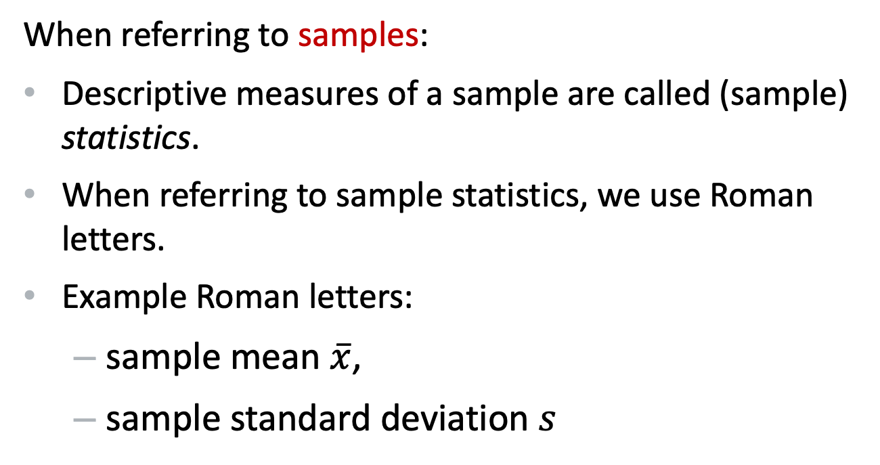
Conventions
When referring to samples:
Descriptive measures of a sample are called (sample) statistics.
When referring to sample statistics, we use Roman letters.
Example Roman letters:
sample mean $\overline{x}$,
sample standard deviation $s$

Slide 11
Descriptive statistics and inferential statistics
Descriptive statistics:
Procedures for classifying or summarizing numerical data.
Inferential statistics:
Procedures for using our sample data to estimate parameters and to test hypotheses about parameters.

Slide 12
Random samples
Subsets of the population in which every member of the population had an equal chance of being selected.
When we sample randomly, each member of the population must have an equal probability of being drawn.

Slide 13
Sample bias
Occurs when the sample is not drawn randomly from the entire population.
That is, every member of the population did not have an equal chance of being drawn.

Slide 14
Why is random sampling so important?
Drawing randomly eliminates the possibility of sample bias.
This is because all confounding factors that could bias the results are equally likely to be present in our random sample.

Slide 15
Examples of Sampling Bias
Self-selecting – participants volunteering or responding to adverts (a study on exercise interventions for health will get you motivated participants who want to achieve better health
Attrition – People who drop out of a study may significantly differ from those who stay (a study on burnout in workplace – who’s likely to not have the time or energy to participate?)
Under-coverage – some population members are not represented (an online study precludes those without internet access, ~6-10%)
Advertising – (advertising on campus will get you students)

Slide 16
Distributions

Slide 17
Distributions
A probability distribution is the mathematical function that gives the probabilities of occurrence of different possible outcomes for an experiment.
It is a mathematical description of a random phenomenon in terms of its sample space and the probabilities of events (subsets of the sample space).

Slide 18
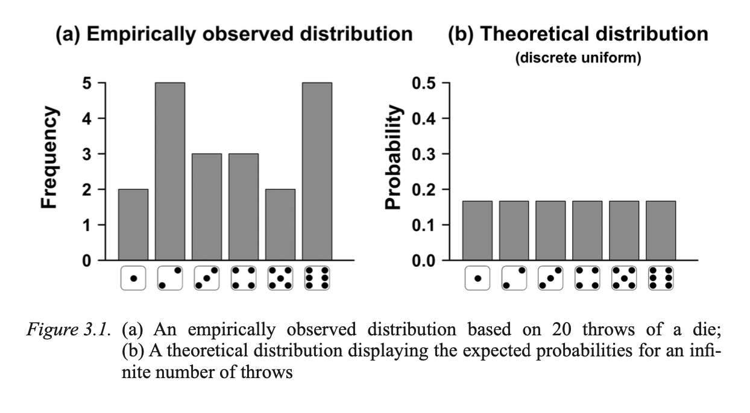
Uniform distribution
A type of distribution in which all outcomes are equally likely.
The shape resembles a square block: the frequency of cases does not change over the range of possible values.

Slide 19
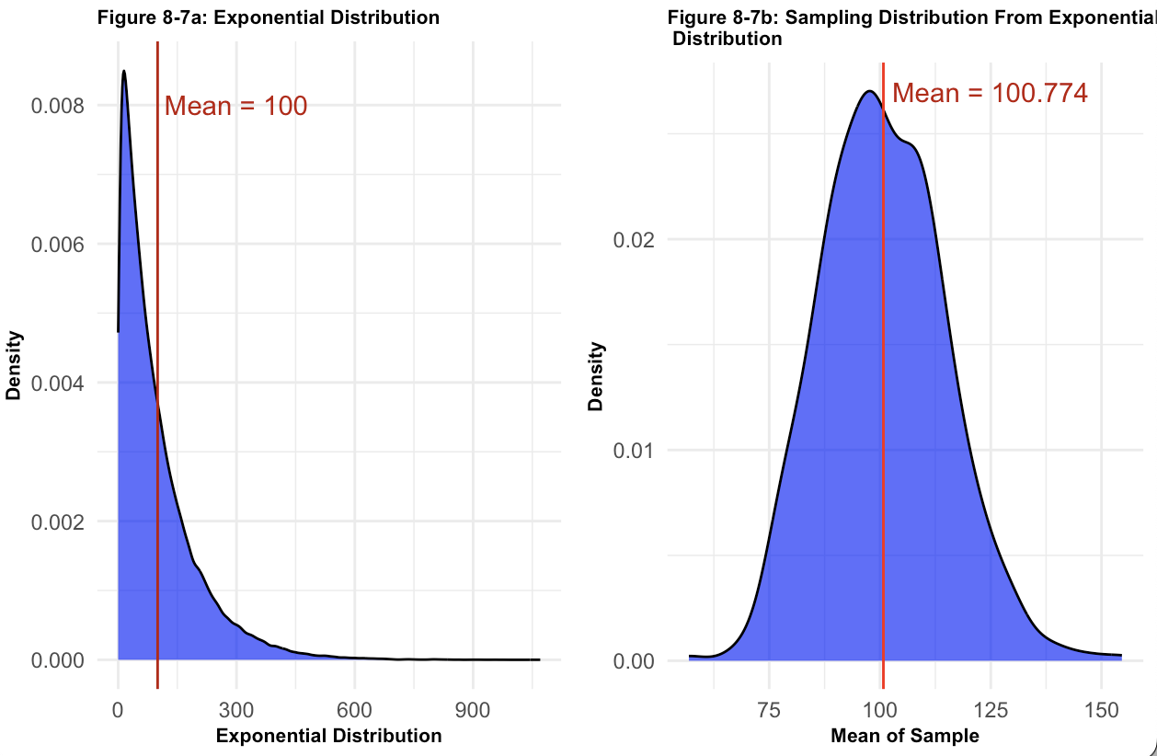
Exponential distribution
A type of distribution that is very skewed either in a negative or positive direction.
A large majority of cases might be grouped together at the low end (positive skew) or the high end (negative skew), with very few cases on the opposing end.
Notes:
VISUAL Figure 8-7A, and dance website

Slide 20
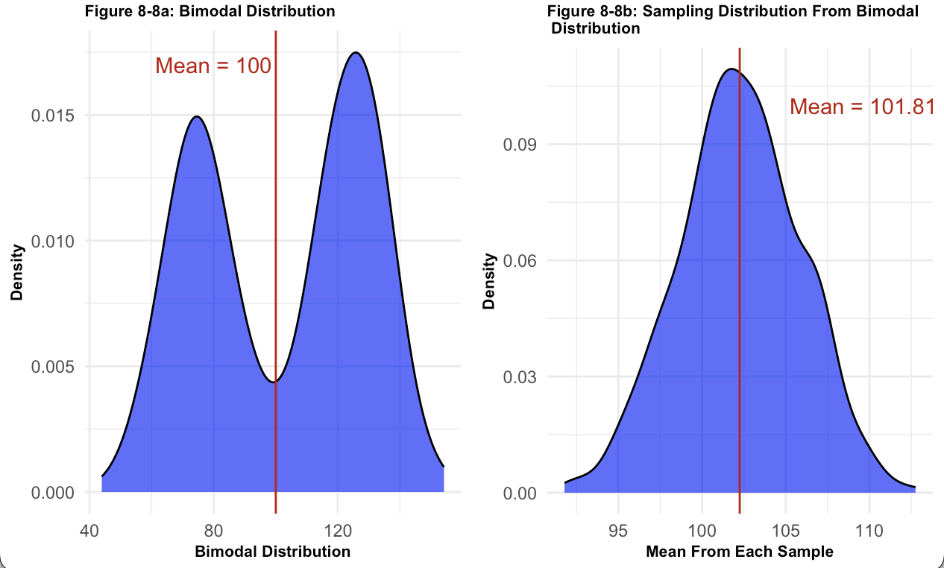
Bimodal distribution
A type of distribution with two modes rather than one.
The shape of a bimodal distribution is characterized by two humps.
Notes:
If you take a random sample from all humans and measure their height, you will find two peaks in the data. This occurs due to genetic differences, on average, between biological men and women.

Slide 21
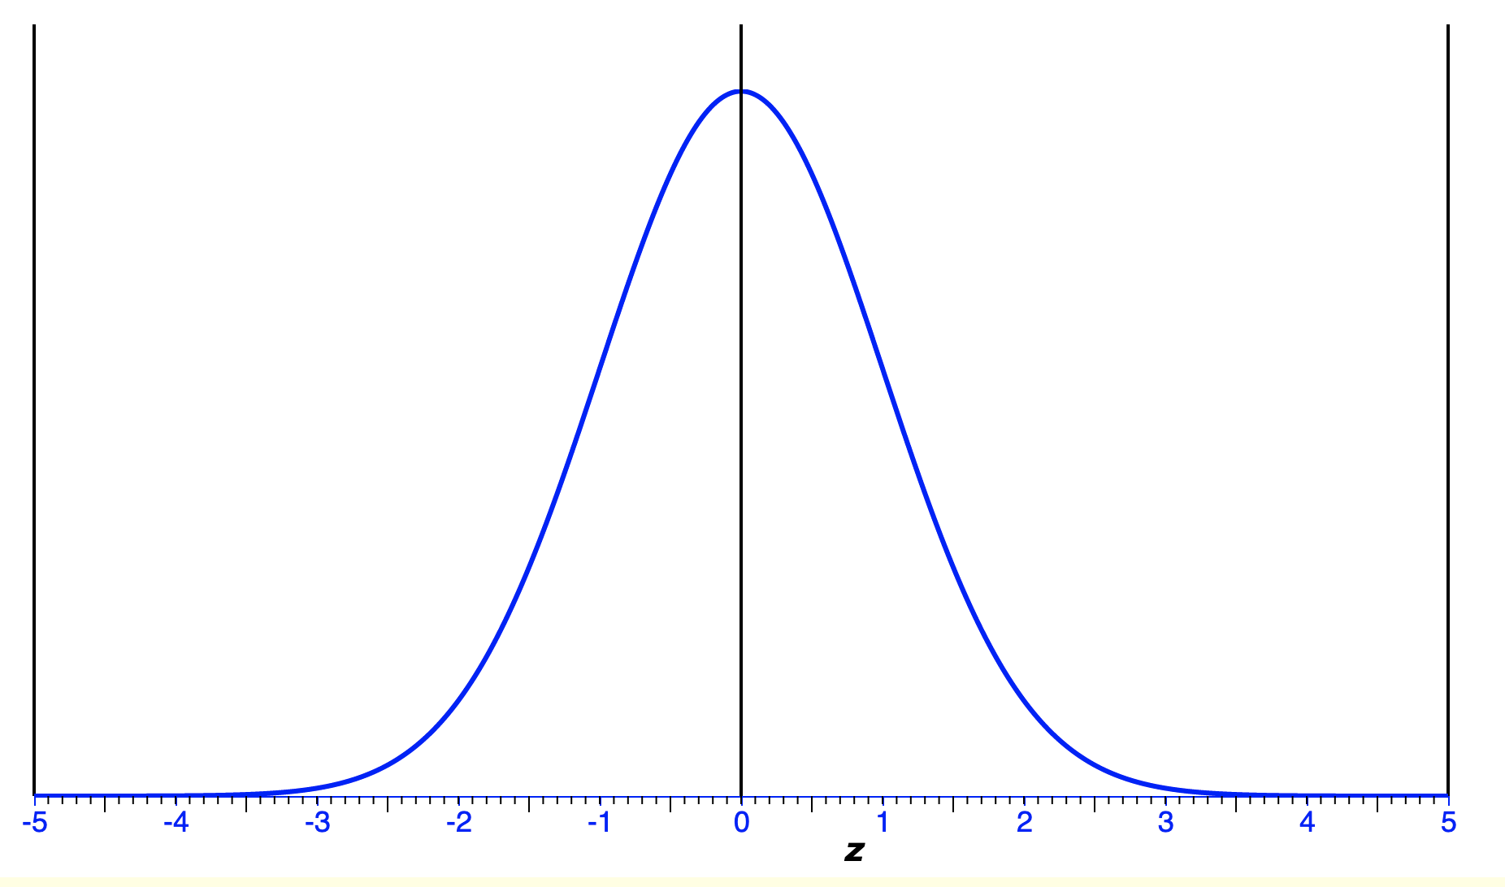
Normal distribution
A type of distribution in which the mean, median and mode are exactly the same.
The distribution is symmetric: half the values fall below the mean and half above the mean.

Slide 22
Normal distribution
Normal distributions resemble a bell shape, with most values clustering the central region (mean), tapering off as the scores move further away from the centre.

Slide 23
Normal distribution
The distribution can be described by two values: the mean and the standard deviation.

Slide 24
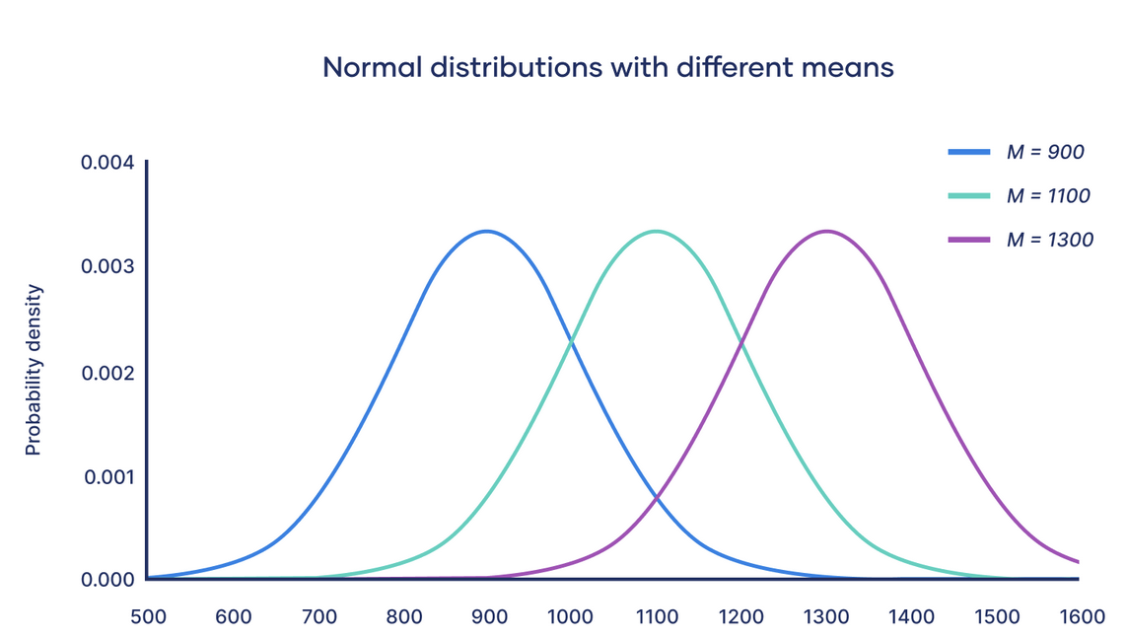
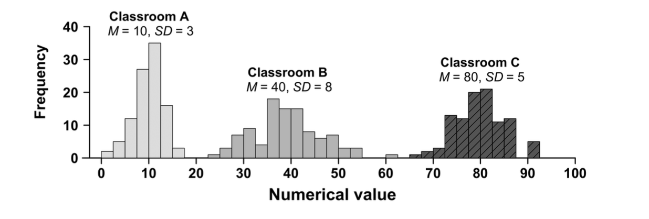
Normal distributions with different means
Notes:
The mean determines the location of the peak of the curve. Increasing the mean moves the curve right, while decreasing it moves the curve left.

Slide 25
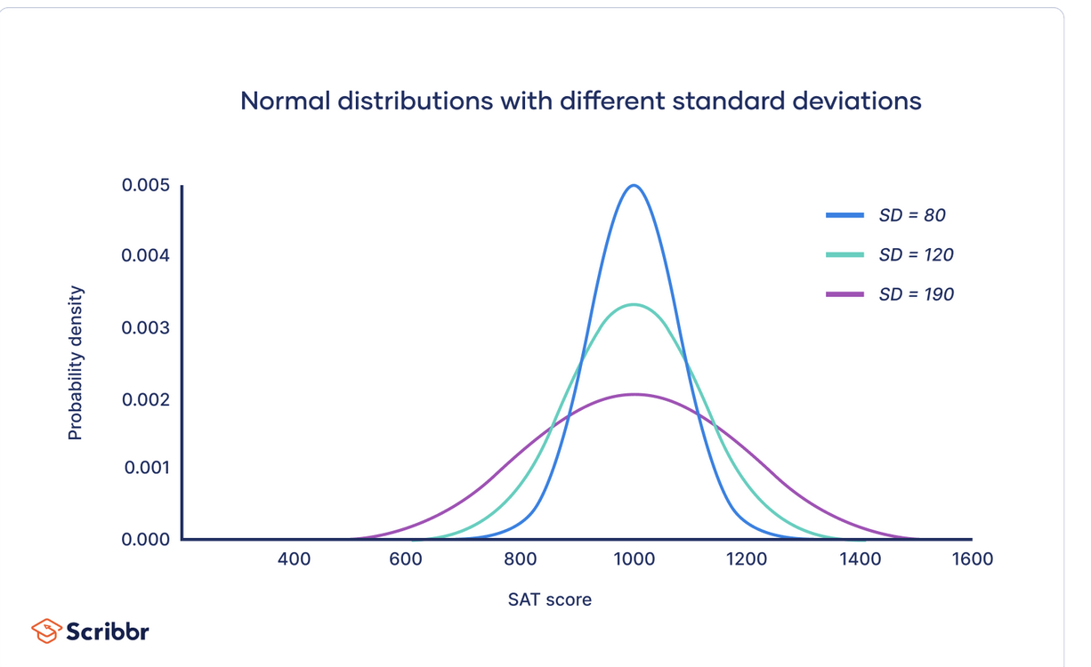
Normal distributions with different standard deviations
Notes:
The standard deviation determines the scale of the curve.

Slide 26
Empirical rule (also known as 68-95-99.7 rule)
This rule tells us where most of your values lie in a normal distribution.

Slide 27
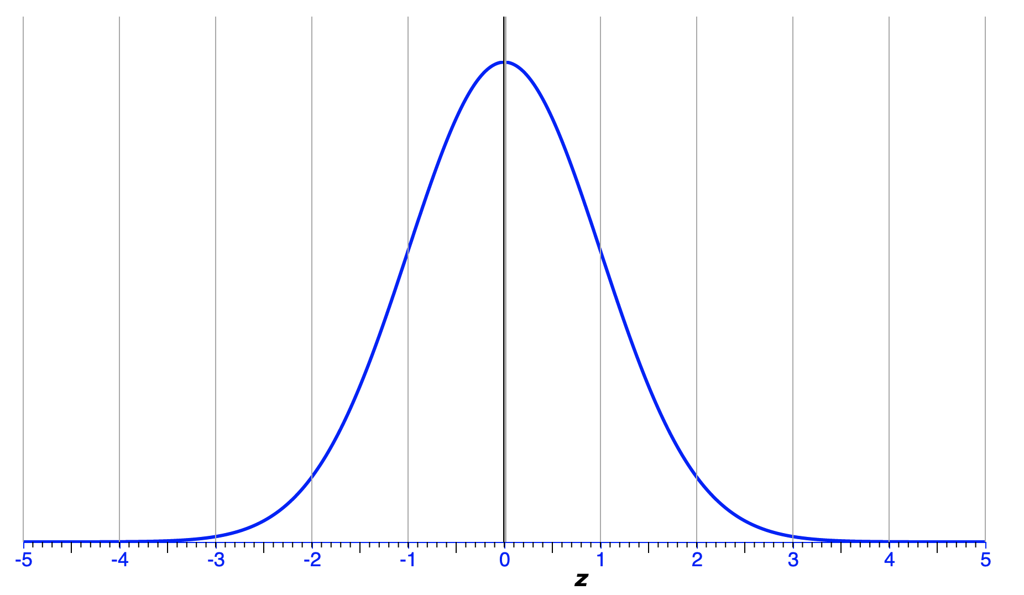
Around 68% of values are within 1 SD from the mean.
A type of distribution in which the mean, median and mode are exactly the same.
The distribution is symmetric: half the values fall below the mean and half above the mean.

Slide 28
Around 95% of values are within 2 SDs from the mean.
A type of distribution in which the mean, median and mode are exactly the same.
The distribution is symmetric: half the values fall below the mean and half above the mean.

Slide 29
Around 99.7% of values are within 3 SDs from the mean.
A type of distribution in which the mean, median and mode are exactly the same.
The distribution is symmetric: half the values fall below the mean and half above the mean.

Slide 30
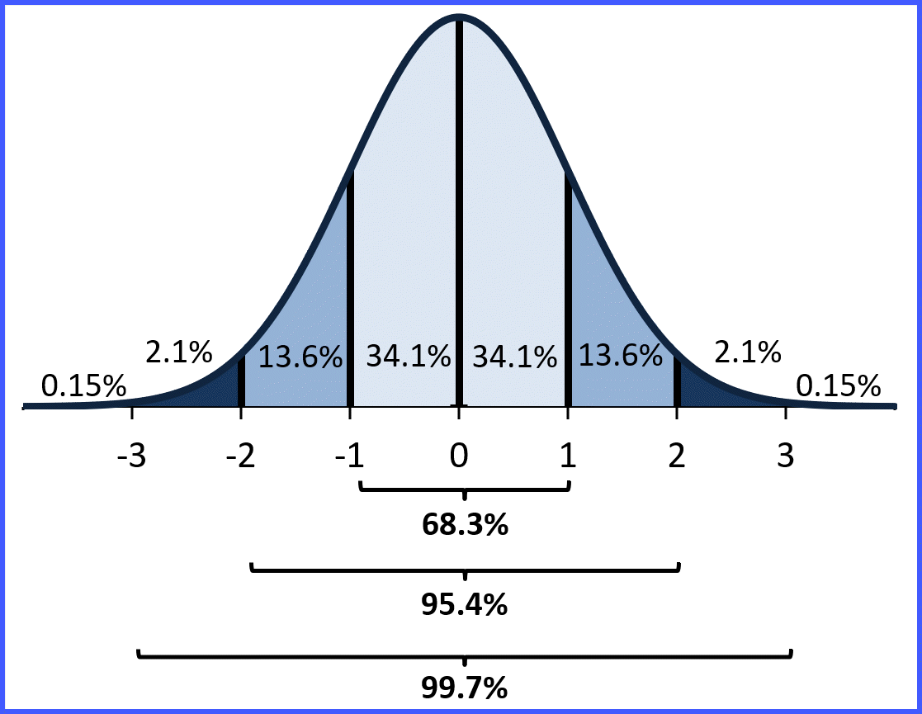
Empirical rule (also known as 68-95-99.7 rule)
This rule tells us where most of your values lie in a normal distribution.

Slide 31
What is a sampling distribution?
A sampling distribution is the distribution of sample statistics (e.g., means) collected from many independent samples.
To build a sampling distribution, we draw a sample from the population, calculate a statistic (e.g., mean) and record it.
We then repeat this again and again.

Slide 32
Handout task 1: What is a sampling distribution?
No datasets to download this week, we will be generating data using R
Notes:
Task 1: Sampling distributions
The psychologist Geoff Cumming wrote an excellent textbook on The New Statistics (confidence intervals, effect sizes, meta-analyses), in which he advocates a significant reform of the way we use statistics in the social sciences.
The following article summarizes his ideas neatly.
Cumming, G. (2014). The New Statistics: Why and How. Psychological Science, 25(1), 7–29. https://doi.org/10.1177/0956797613504966
The following recordings of one of Cumming’s workshop are also worth watching:
https://www.psychologicalscience.org/members/new-statistics
Cumming developed a very helpful software package (ESCI, Exploratory Software for Confidence Intervals) that we will use over the coming weeks to illustrate important ideas in statistics. You can access the software and the companion website here:
https://www.esci.thenewstatistics.com/

Slide 33
Handout task 1: What is a sampling distribution?
The psychologist Geoff Cumming wrote an excellent textbook on The New Statistics.
Cumming advocates a significant reform of the way we use statistics in the social sciences.
See also: Cumming, G. (2014). The New Statistics: Why and How. Psychological Science, 25(1), 7–29.
Notes:
Task 1: Sampling distributions
The psychologist Geoff Cumming wrote an excellent textbook on The New Statistics (confidence intervals, effect sizes, meta-analyses), in which he advocates a significant reform of the way we use statistics in the social sciences.
The following article summarizes his ideas neatly.
Cumming, G. (2014). The New Statistics: Why and How. Psychological Science, 25(1), 7–29. https://doi.org/10.1177/0956797613504966
The following recordings of one of Cumming’s workshop are also worth watching:
https://www.psychologicalscience.org/members/new-statistics
Cumming developed a very helpful software package (ESCI, Exploratory Software for Confidence Intervals) that we will use over the coming weeks to illustrate important ideas in statistics. You can access the software and the companion website here:
https://www.esci.thenewstatistics.com/

Slide 34
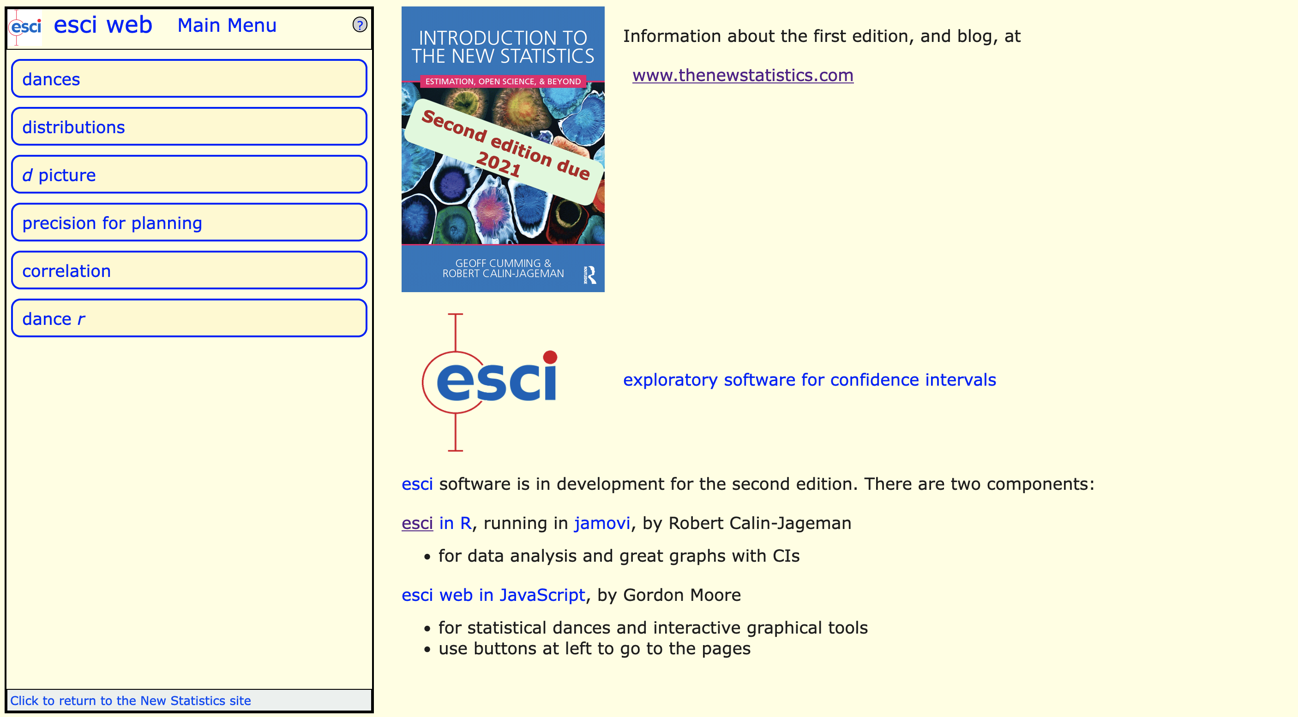
ESCI: Exploratory Software for Confidence Intervals
https://www.esci.thenewstatistics.com/
Notes:
Task 1: Sampling distributions
The psychologist Geoff Cumming wrote an excellent textbook on The New Statistics (confidence intervals, effect sizes, meta-analyses), in which he advocates a significant reform of the way we use statistics in the social sciences.
The following article summarizes his ideas neatly.
Cumming, G. (2014). The New Statistics: Why and How. Psychological Science, 25(1), 7–29. https://doi.org/10.1177/0956797613504966
The following recordings of one of Cumming’s workshop are also worth watching:
https://www.psychologicalscience.org/members/new-statistics
Cumming developed a very helpful software package (ESCI, Exploratory Software for Confidence Intervals) that we will use over the coming weeks to illustrate important ideas in statistics. You can access the software and the companion website here:
https://www.esci.thenewstatistics.com/

Slide 35
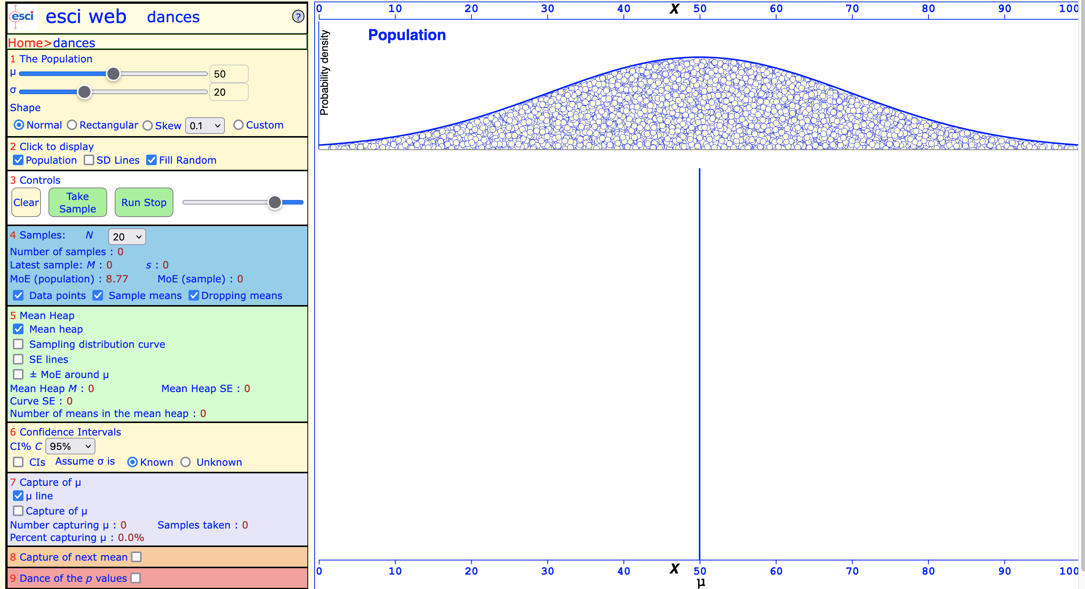
Handout task 1: What is a sampling distribution?
Notes:
Task 1: Sampling distributions
The psychologist Geoff Cumming wrote an excellent textbook on The New Statistics (confidence intervals, effect sizes, meta-analyses), in which he advocates a significant reform of the way we use statistics in the social sciences.
The following article summarizes his ideas neatly.
Cumming, G. (2014). The New Statistics: Why and How. Psychological Science, 25(1), 7–29. https://doi.org/10.1177/0956797613504966
The following recordings of one of Cumming’s workshop are also worth watching:
https://www.psychologicalscience.org/members/new-statistics
Cumming developed a very helpful software package (ESCI, Exploratory Software for Confidence Intervals) that we will use over the coming weeks to illustrate important ideas in statistics. You can access the software and the companion website here:
https://www.esci.thenewstatistics.com/

Slide 36
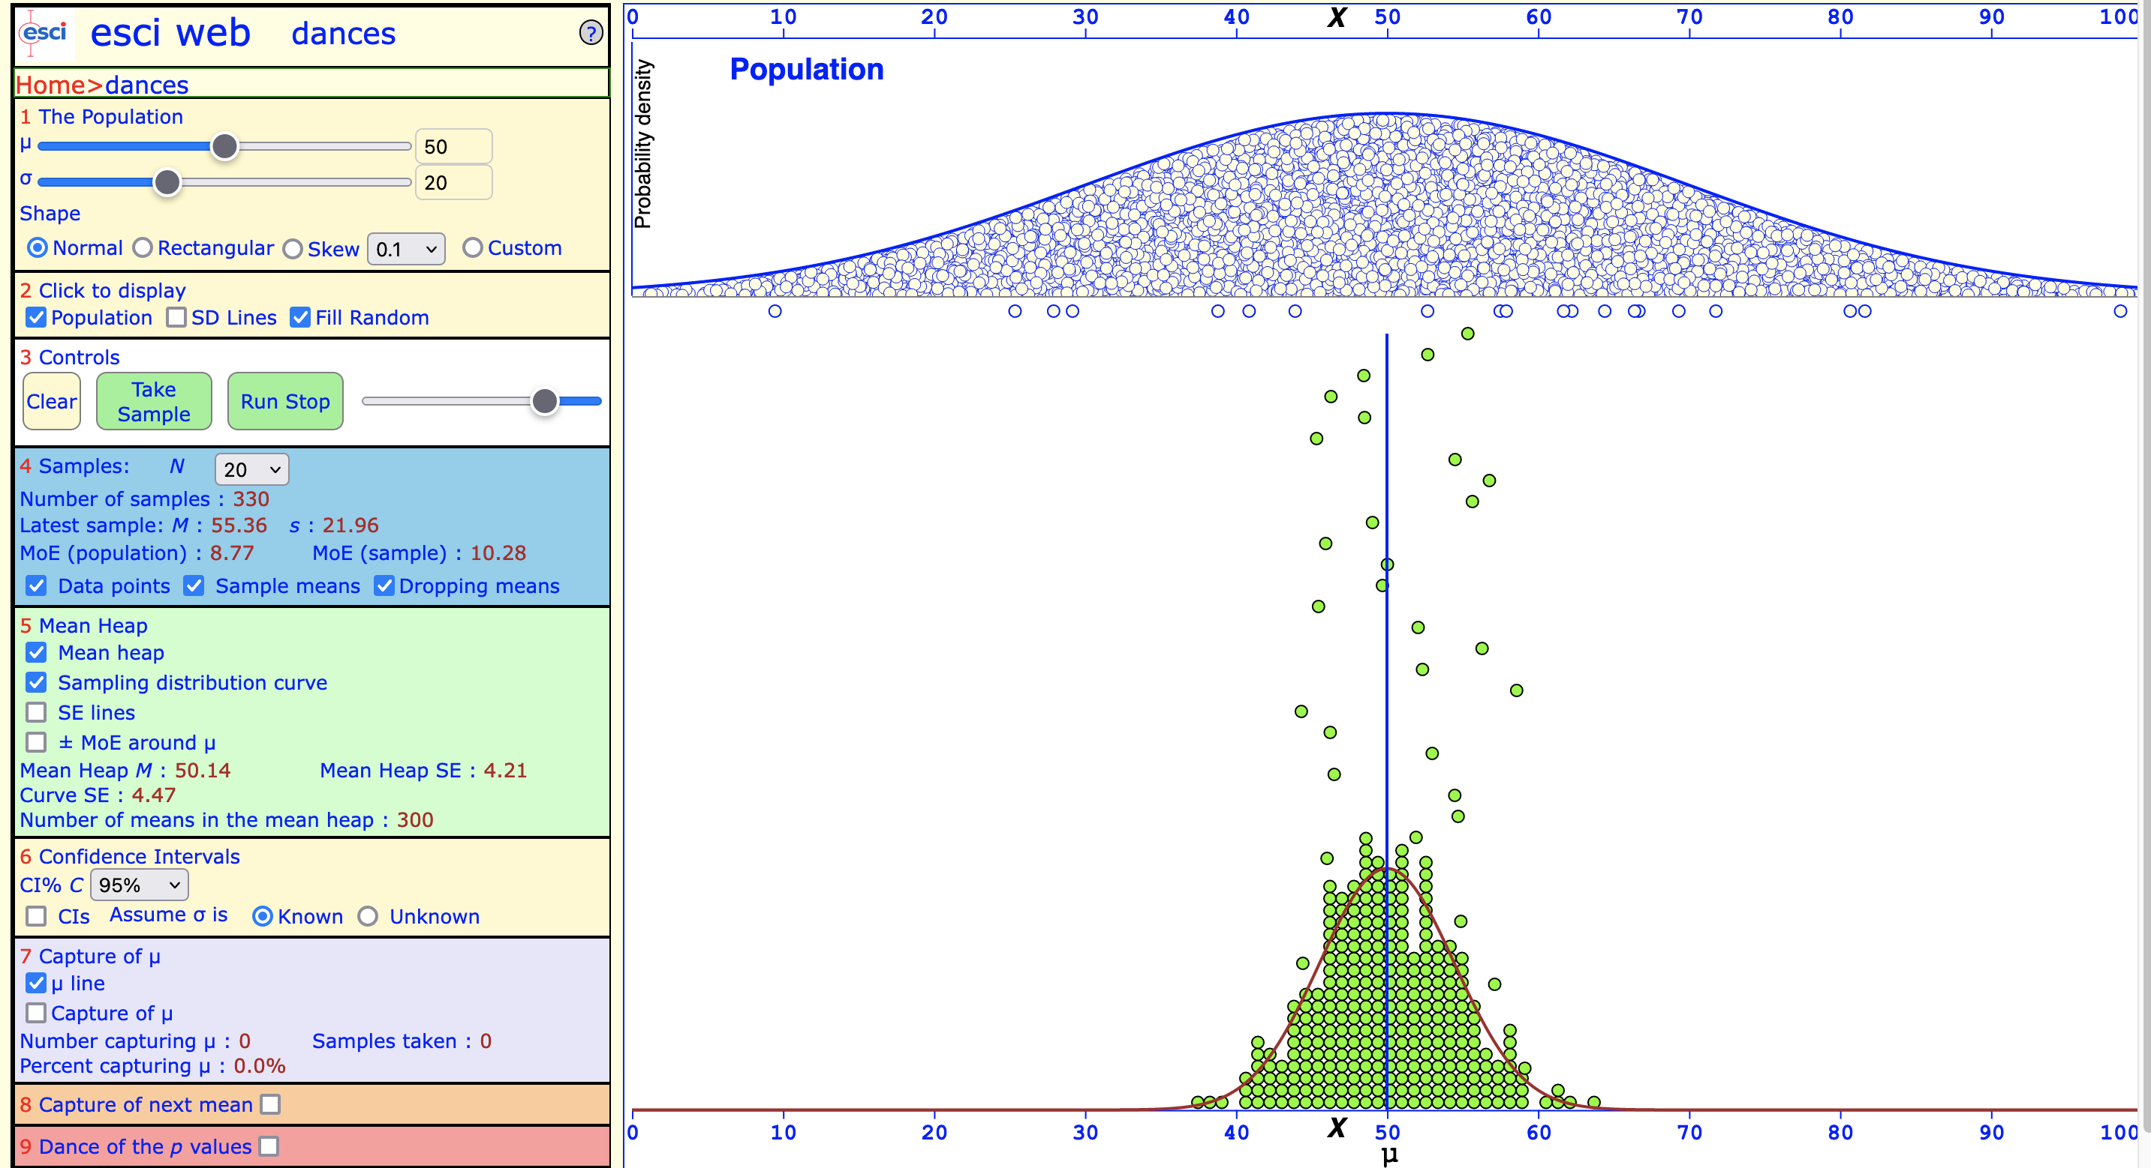
Handout task 1: What is a sampling distribution?

Slide 37
Questions?

Slide 38
Why do normal distributions matter?
Normal curve approximates the distribution of many naturally occurring and human-made phenomena (Tijms, 2004).
Adolphe Quetelet (1835): Showed that human traits were distributed according to a normal curve (height, birth weight, etc.)

Slide 39
Why do normal distributions matter?
Many other phenomena (shoe size, exam scores, IQ score, stock market prices, etc.) also follow a normal distribution.
Because normally distributed variables are so common, many statistical tests are designed for normally distributed populations.

Slide 40
Why do normal distributions matter?
Understanding the properties of normal distributions (e.g., the Empirical Rule) means we can use probability theory to compare different groups and make estimates about populations using samples.

Slide 41
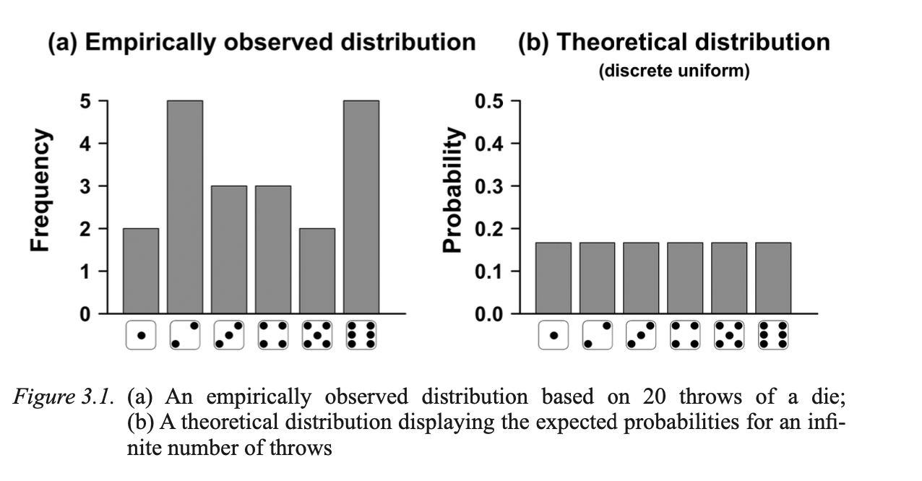
Empirical and theoretical distributions

Slide 42
Handout task 2

Slide 43
Handout task 2: Playing around with the normal distribution
What happens when we run the following command five times? Observe the shape of the histogram
hist(rnorm(n = 20)) # Five times
How does sample size affect the shape of the distribution?
hist(rnorm(n = 5, 10, …, 1000))

Slide 44
Questions?

Slide 45
Probability theory

Slide 46
Probability theory
Remember that, ultimately, we are interested in populations, not the samples drawn from them.
We take a random sample and calculate a statistic from the sample (e.g., the sample mean).
We then use probability theory to calculate precisely how closely our sample statistic approximates the true population parameter (e.g., the population mean).

Slide 47
Probability theory
Two fundamental concepts of probability theory underpin this:
Law of Large Numbers
Central Limit Theorem

Slide 48
The Law of Large Numbers
A theorem that describes the result of performing the same experiment a large number of times.
This could mean rolling dice many times, drawing many independent samples from our population of interest, and so forth.
First formal proof by Jakob Bernoulli (1713)

Slide 49
The LLN states….
We can determine characteristics of a population as long as we draw enough samples.
The more random samples we draw from the population, the closer we get to the population parameter.

Slide 50
What happens to the mean scores when you keep rolling a fair die

Slide 51
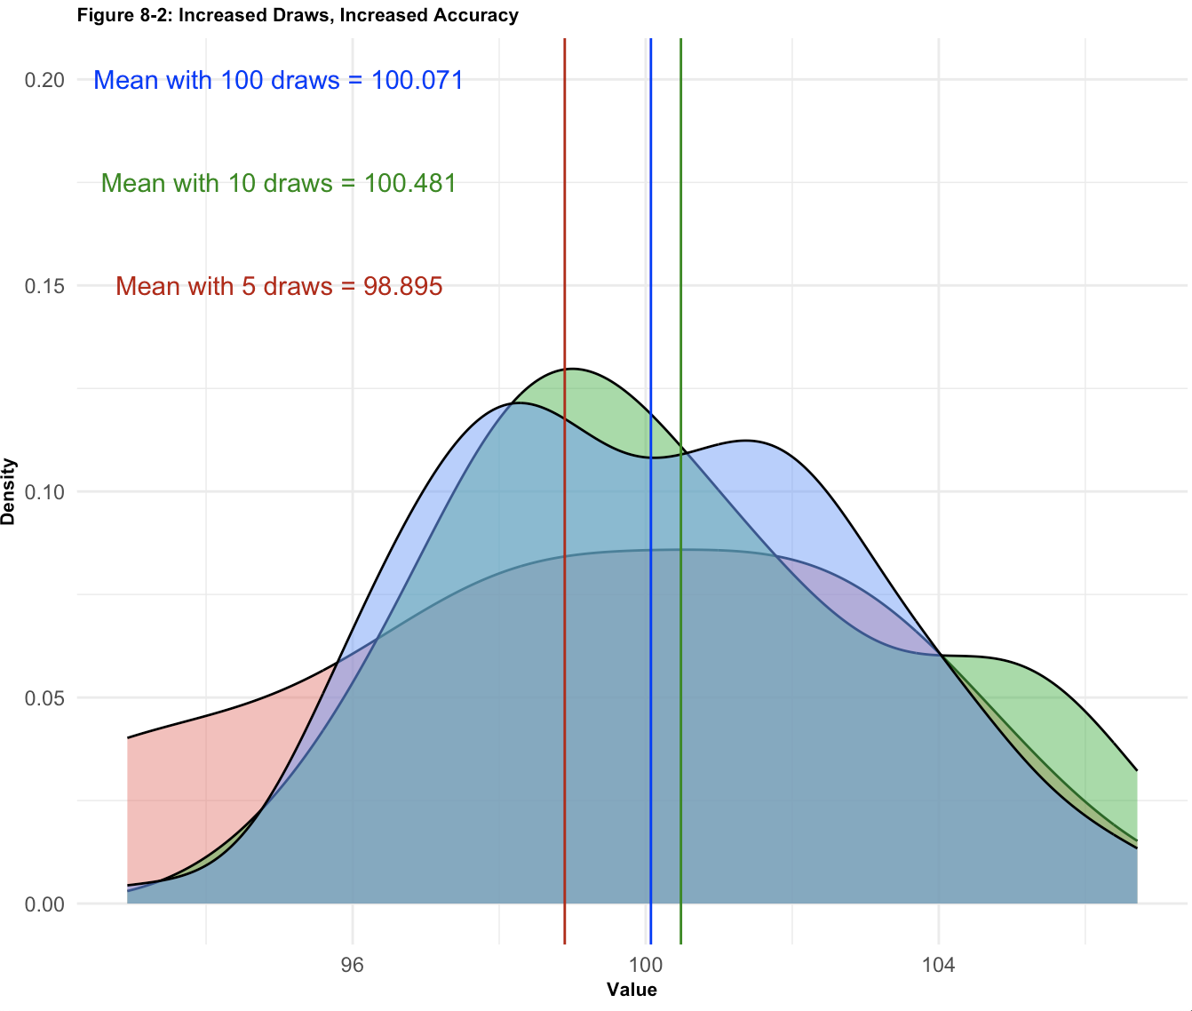
Handout task 3: The LLN in action
How does the number of randomly-drawn samples (5, 10, 100 draws) affect the three sampling distributions and the mean of each?

Slide 52
Questions?

Slide 53
The Central Limit Theorem
LLN states: The more you sample, the truer your sample mean is to the average mean of the population.
But: We cannot draw an infinite number of samples as time and money are finite! Luckily, we don’t have to, and the CLT explains why.

Slide 54
The CLT states…
As the number of observations increases in each sample, the shape of the sampling distribution will approximate a normal distribution.
The sampling distribution of the mean will always be normally distributed, as long as the sample size is large enough.
This holds true even if the population is not normally distributed!
This is helpful because if we know that the sampling distribution will begin to look like a standard normal curve, we can calculate exactly how far we are from the population parameter (the true mean of the population).

Slide 55
Handout task 4: Let’s confirm this!

Slide 56
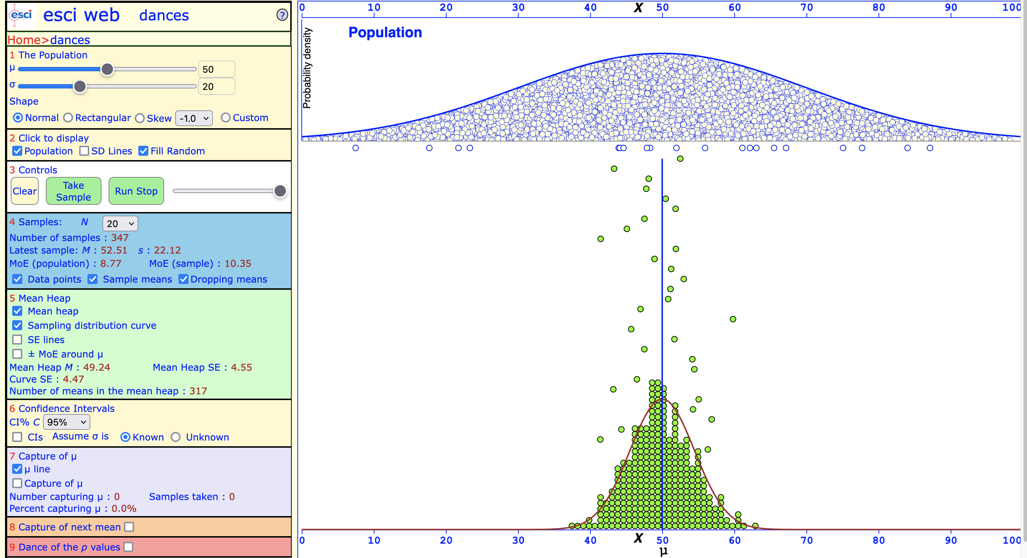
Population distribution: Normal

Slide 57
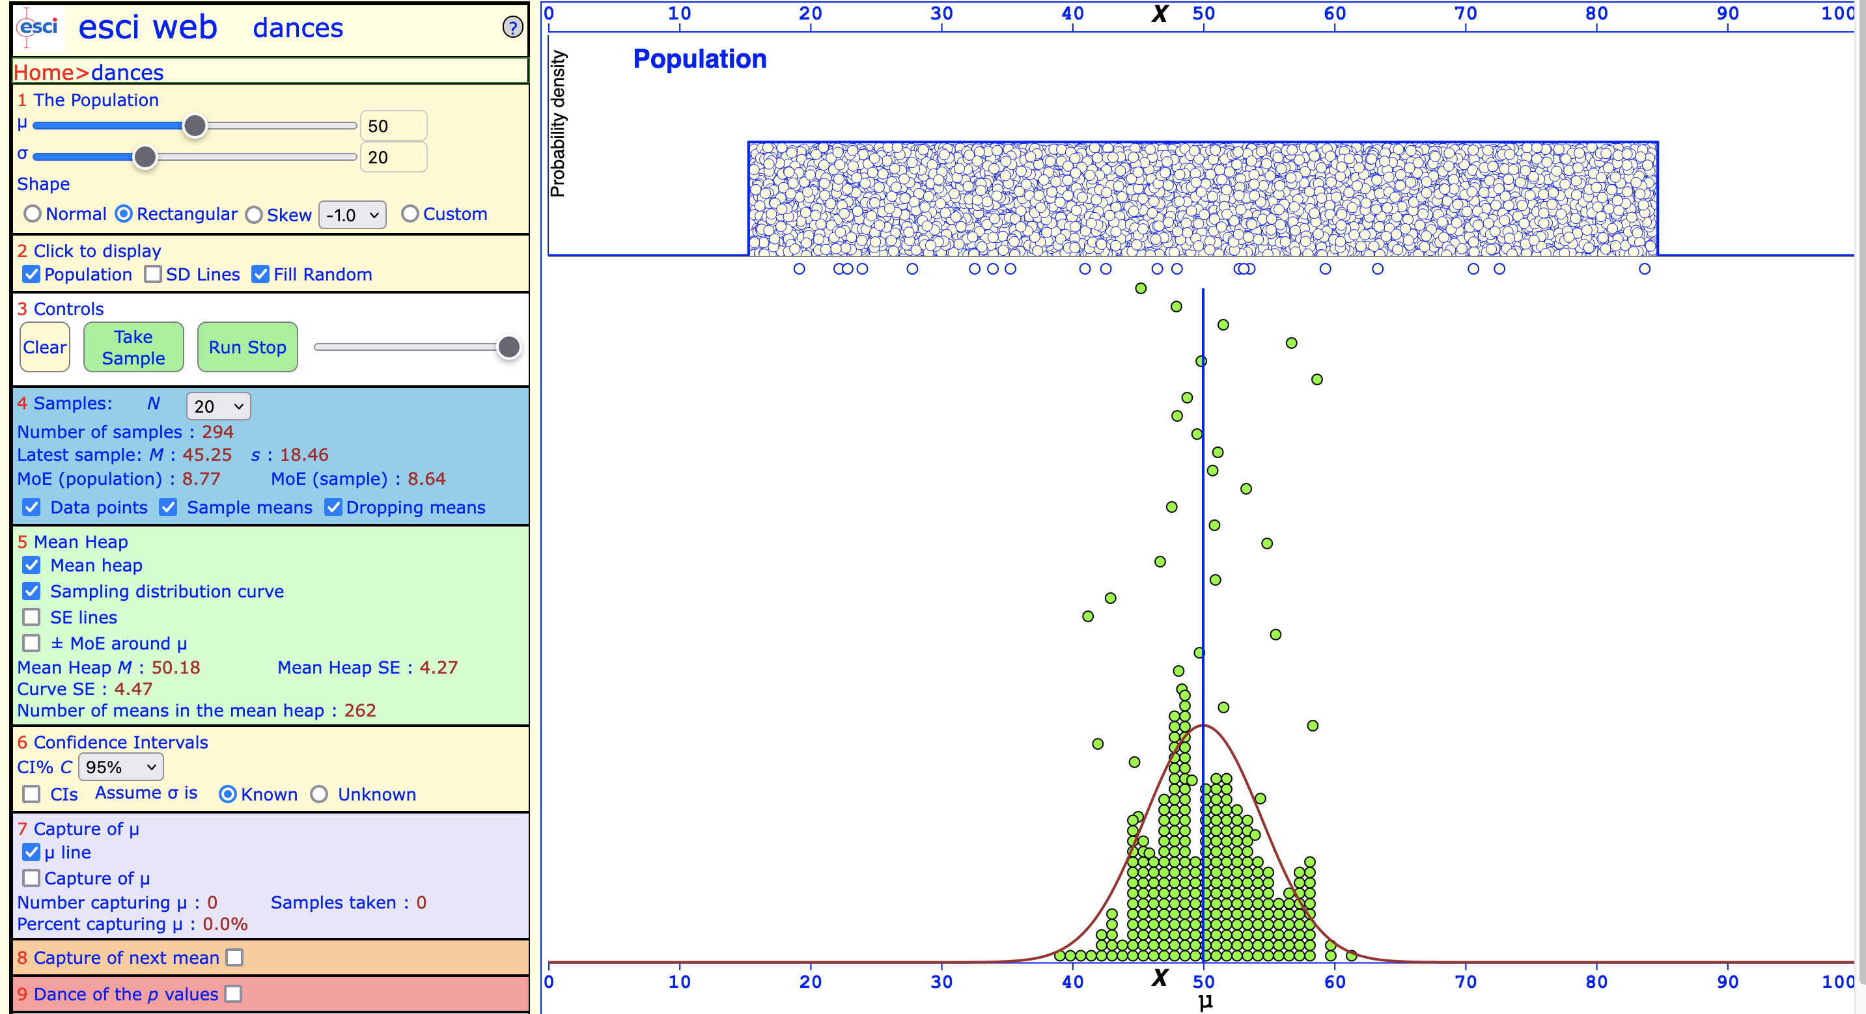
Population distribution: Uniform (rectangular)

Slide 58
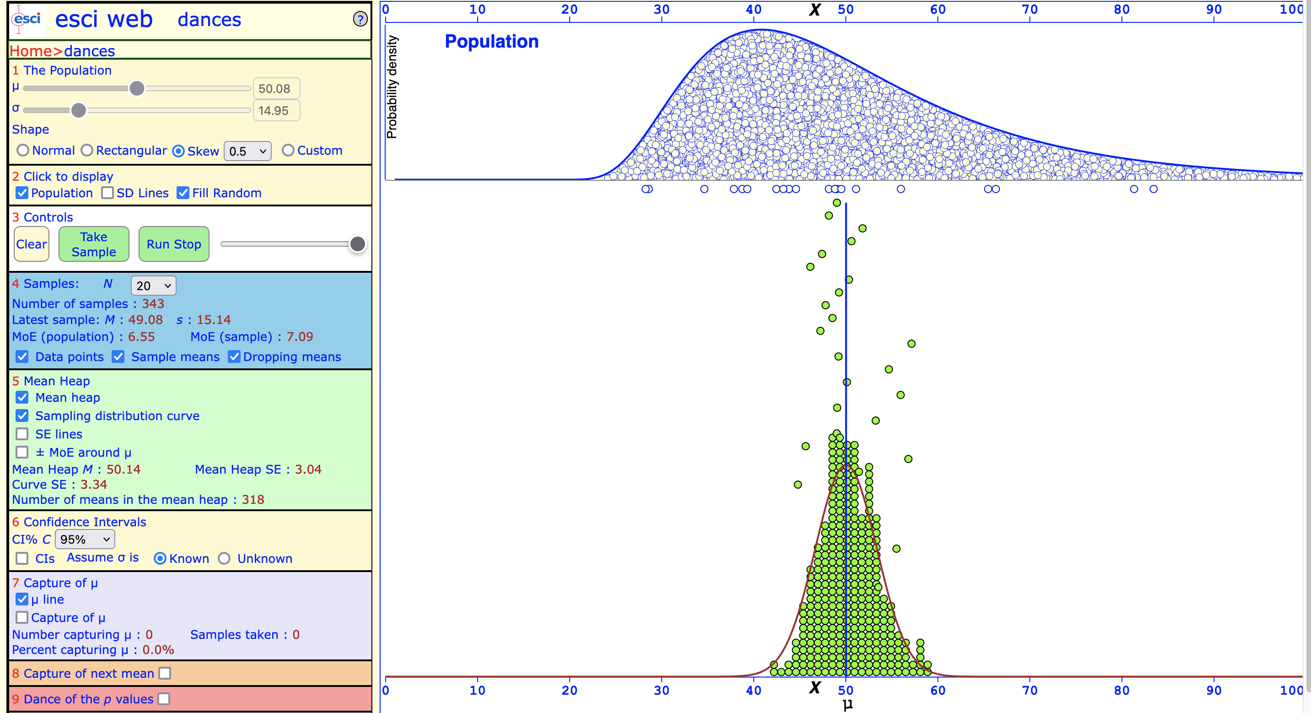
Population distribution: Positive skew

Slide 59
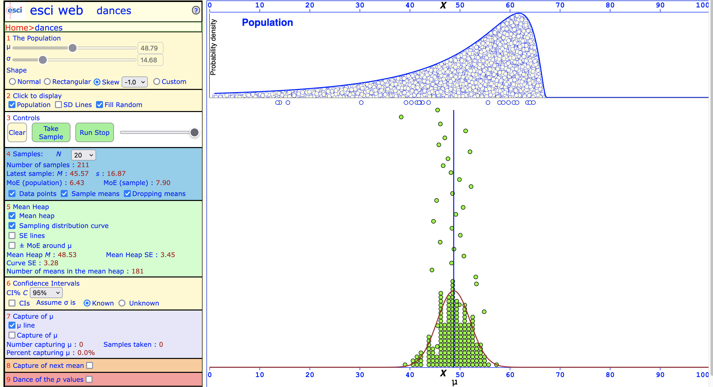
Population distribution: Negative skew

Slide 60
Questions?

Slide 61
The shape of sampling distributions approaches the standard normal curve
This is really useful!
We can use what we know about normal distributions (e.g., the 68-95 rule) to calculate how far our sample statistic might be from the population parameter.
We can also obtain a sense of how confident we should be in our estimate.

Slide 62
Sample size matters
If we know that the population is normally distributed, we don’t need a lot of observations in our samples.
In this case, the sampling distribution will approach normality even when the number of observations in our sample is small.
This is helpful as we need fewer observations in our sample in this case.

Slide 63
Sample size matters
However, if the population distribution is not normally distributed (or if we simply don’t know the distribution of the population), we need to have more observations.

Slide 64
Sample size matters
Increasing the number of observations in each sample increases the accuracy of our estimate.
The more information we have, the more accurate our predictions!
We can determine the necessary sample using statistical power - "If I run my experiment 100 times, how many times will I find a significant result?"

Slide 65
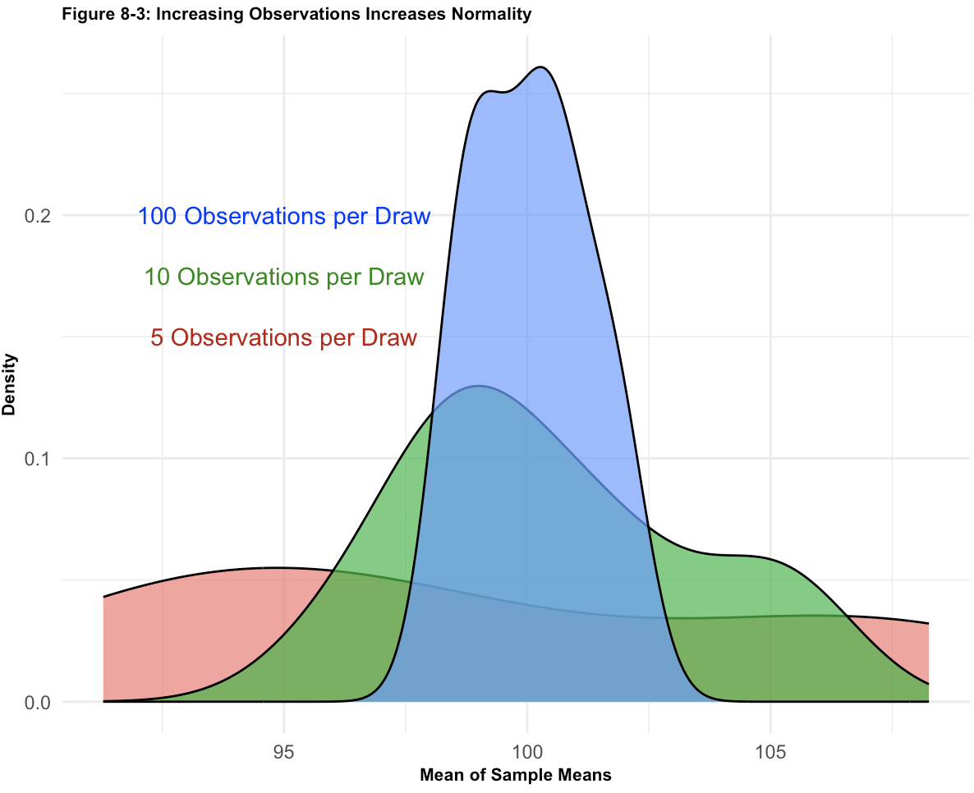
Handout task 5: The CLT in action
How does changing the number of observations (n = 5, 10, 100) affect the three sampling distributions?
Notes:
EXAMPLE: Sampling distribution of means approaches normality as n increases
If we increase the number of observations in each sample (e.g., from 10 to 100), the sampling distribution of means will approach a normal distribution.

Slide 66
Sampling from different distributions
No matter the shape of our population’s distribution, the sampling distribution we construct from it will approximate a symmetrical, normal-looking distribution.
Notes:
Since the sampling distributions in our figures approximate the normal distribution, we have met the conditions to use the normal curve (the standard normal distribution), a device to evaluate the accuracy of the statistics we draw from each sample.

Slide 67
Sampling from different distributions

Slide 68
Handout: Sampling from different distributions

Slide 69
Handout: Sampling from different distributions

Slide 70
Compare LLN and CLT
LLN: If we increase the number of samples (5, 10, 50 samples, each n = 10), then the mean of the sampling distribution will approach the population parameter (the true population mean).
CLT: If we increase the number of observations in each sample (n = 10, 50, 100), then the shape of the sampling distribution will converge to a normal distribution.

Slide 71
Questions?
I will be walking around while you work through the worksheet

